Slide 1
Geography Week
Day 3

Slide 2
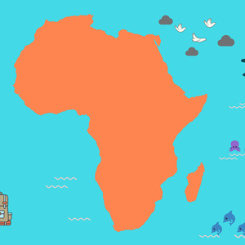
What can you remember?
What can you remember about the continent of Africa?

Slide 3
All About Asia
Consider what you know about these questions:
How many different countries are there in the continent of Asia?
What are the most interesting facts about Asia?
How different are the economies in countries within Asia?

Slide 4
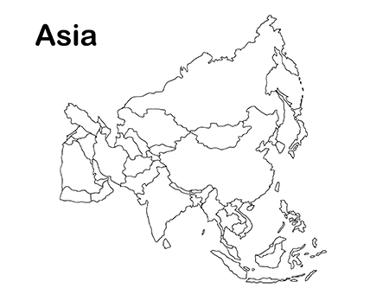
All About Asia
How many countries are there in Asia? Read here to find out more:
https://www.worldatlas.com/articles/how-many-countries-are-in-asia.html

Slide 5
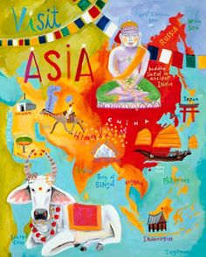
All About Asia
Find the 5 most interesting facts about Asia. See here:
https://www.kids-world-travel-guide.com/asia-facts.html
Create a fact file about Asia.

Slide 6
All About Asia
A country’s economy is the system of money and resources for a country.
Compare the economies of two countries in Asia:
China
Afghanistan
Write a paragraph explaining your answer the different economies and wealth in each country.

Slide 7
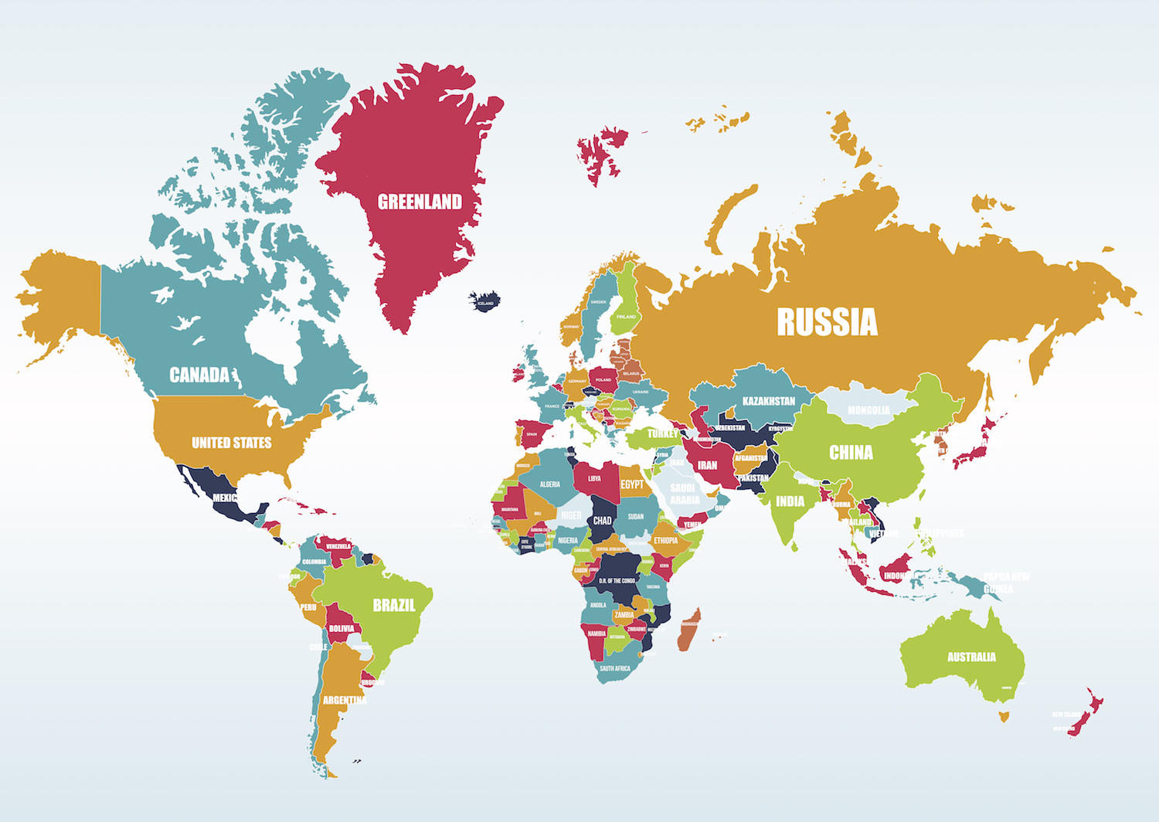
All About Asia
Create a poster about an Asian country of your choice:
Include:
Social features e.g. cuisine
Political features e.g. government
Environment e.g. different habitats
Economic e.g. wealth and poverty

Slide 8
All About Asia
Tell mum or dad about similarities and differences between Africa and Asia.
Can you explain why the country you selected for your fact file is so interesting?

