Slide 1
Geography Week
Day 2

Slide 2
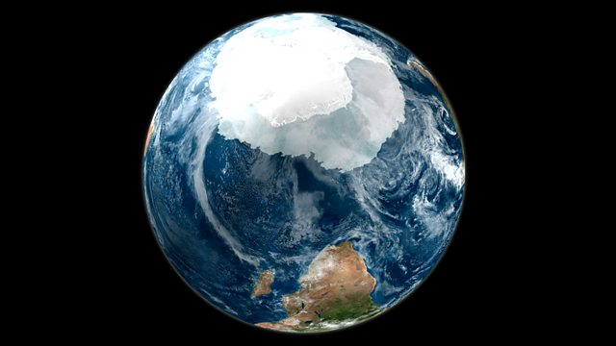
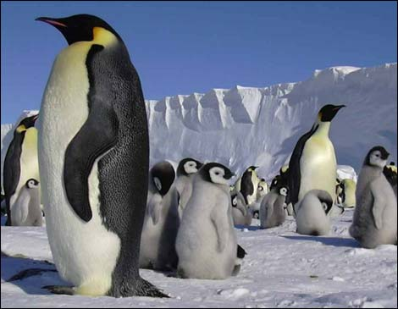
What can you remember?
What can you remember about the continent of Antarctica?

Slide 3
All About Africa
Consider what you know about these questions:
How many different countries are there in the continent of Africa?
What economic challenges do many African countries face?
What do you know about the history of Africa and the damaging impact of European countries?
How is Africa similar or different to Antarctica?

Slide 4
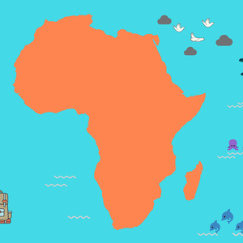
All About Africa
Find out how many countries are in Africa. See here:
https://moafrikatours.com/how-many-countries-are-in-Africa

Slide 5
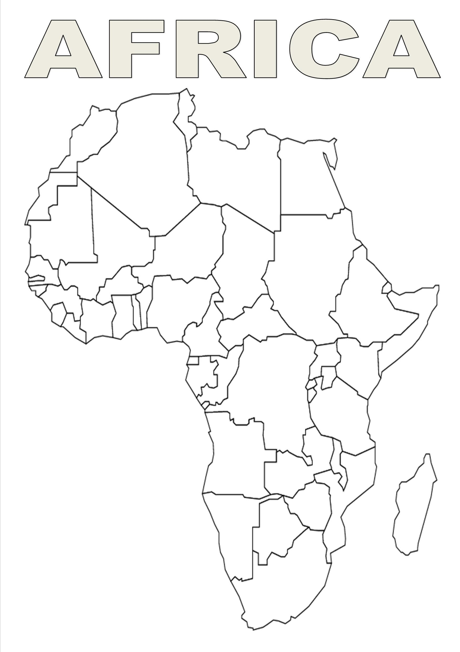
All About Africa
Draw and label a map of Africa with as many of the countries as you can.

Slide 6
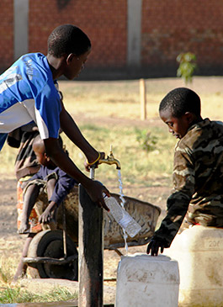
All About Africa
What economic challenges does Africa face? See here:
https://www.children.org/global-poverty/global-poverty-facts/africa
Explain to us the challenges many children face in Africa.

Slide 7
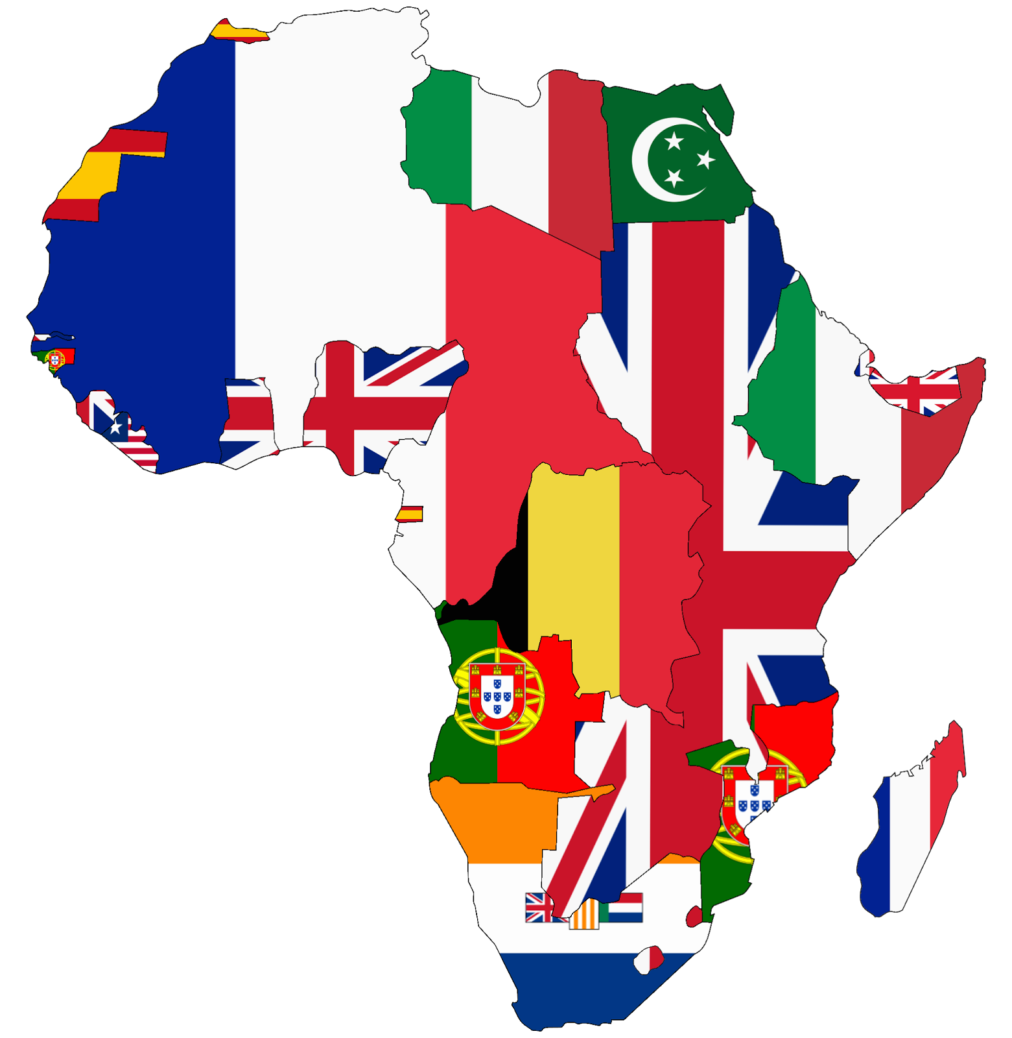
All About Africa
What do we know about the impact of European countries on Africa?
Watch this video: https://www.youtube.com/watch?v=PzF88HBlAHY.
List 5 facts you have learned.

Slide 8
All About Africa
Tell mum or dad the differences and similarities between Africa and Antarctica.
What positive success stories can you find about Africa and Antarctica?

