Slide 1
Science Week
Day 3

Slide 2
What you will need
Pencil/pen and paper
Coloured pens/pencils
A laptop or computer
See Kitchen Science Booklet for more…

Slide 3
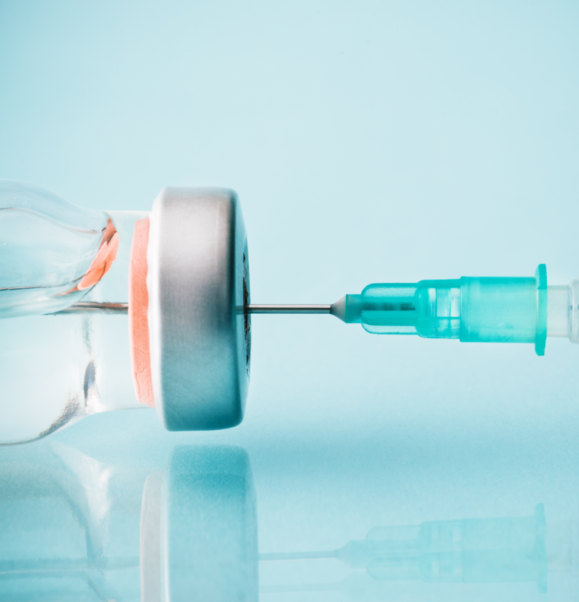
Finding out about Vaccines
Read the following webpage (https://rb.gy/yp5orf) and do online research to answer these following question:
Who invented vaccines?
What is a vaccine?
Where does the word vaccine come from?
Why are they so important to the world?

Slide 4
Edward Jenner
Read the E-bug article about Edward Jenner. How many lives do you think Jenner and other scientists may have saved due to vaccination?

Slide 5
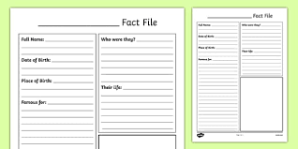
Scientists and Vaccines
Explore these other amazing female scientists involved in vaccinations: https://rb.gy/ppemxr.
Now, select one of the scientists – do some internet research and create a short ‘Scientist Factfile’.

Slide 6
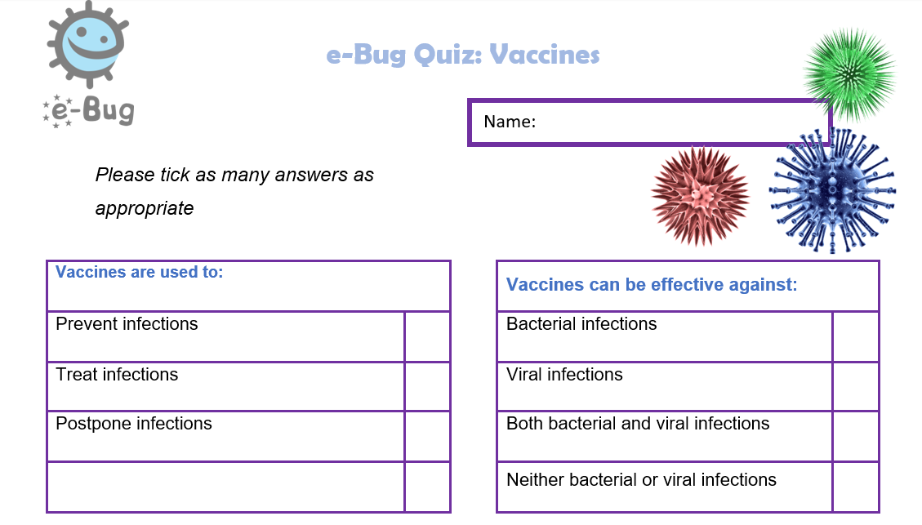
The Body’s Defence System
Now, take on the E-Bug quiz on vaccinations.
Find the answers on the E-Bug quiz answers sheet.

Slide 7
Vaccines
Summarise everything your have learned about vaccines to Mum and Dad

Slide 8
Kitchen Science
Now, pick a kitchen experiment and record your findings.

