Slide 1
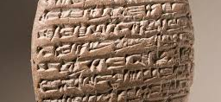
History Week
(Day 5)

Slide 2
What you will need…
HELP
Plain paper, pencil / pen
Coloured pencils/pens/paint

Slide 3
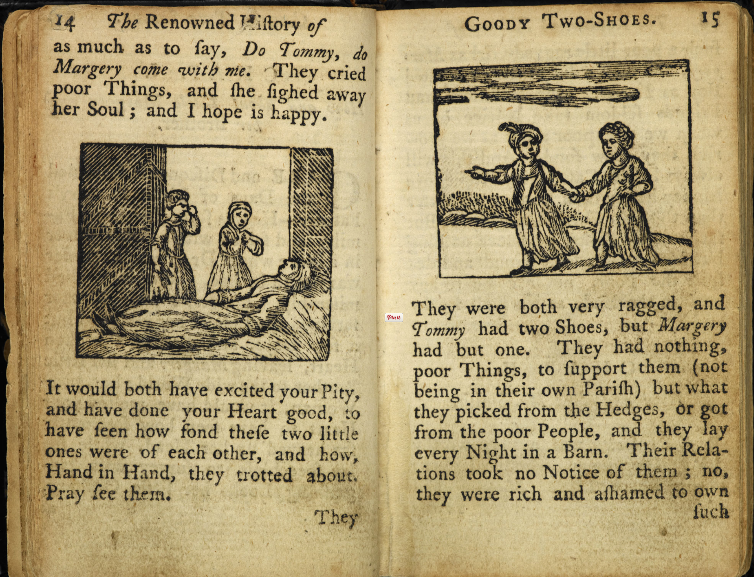
What can you remember?
HELP
What can you remember about ‘goody two-shoes’?
How has reading changed for children across time?

Slide 4
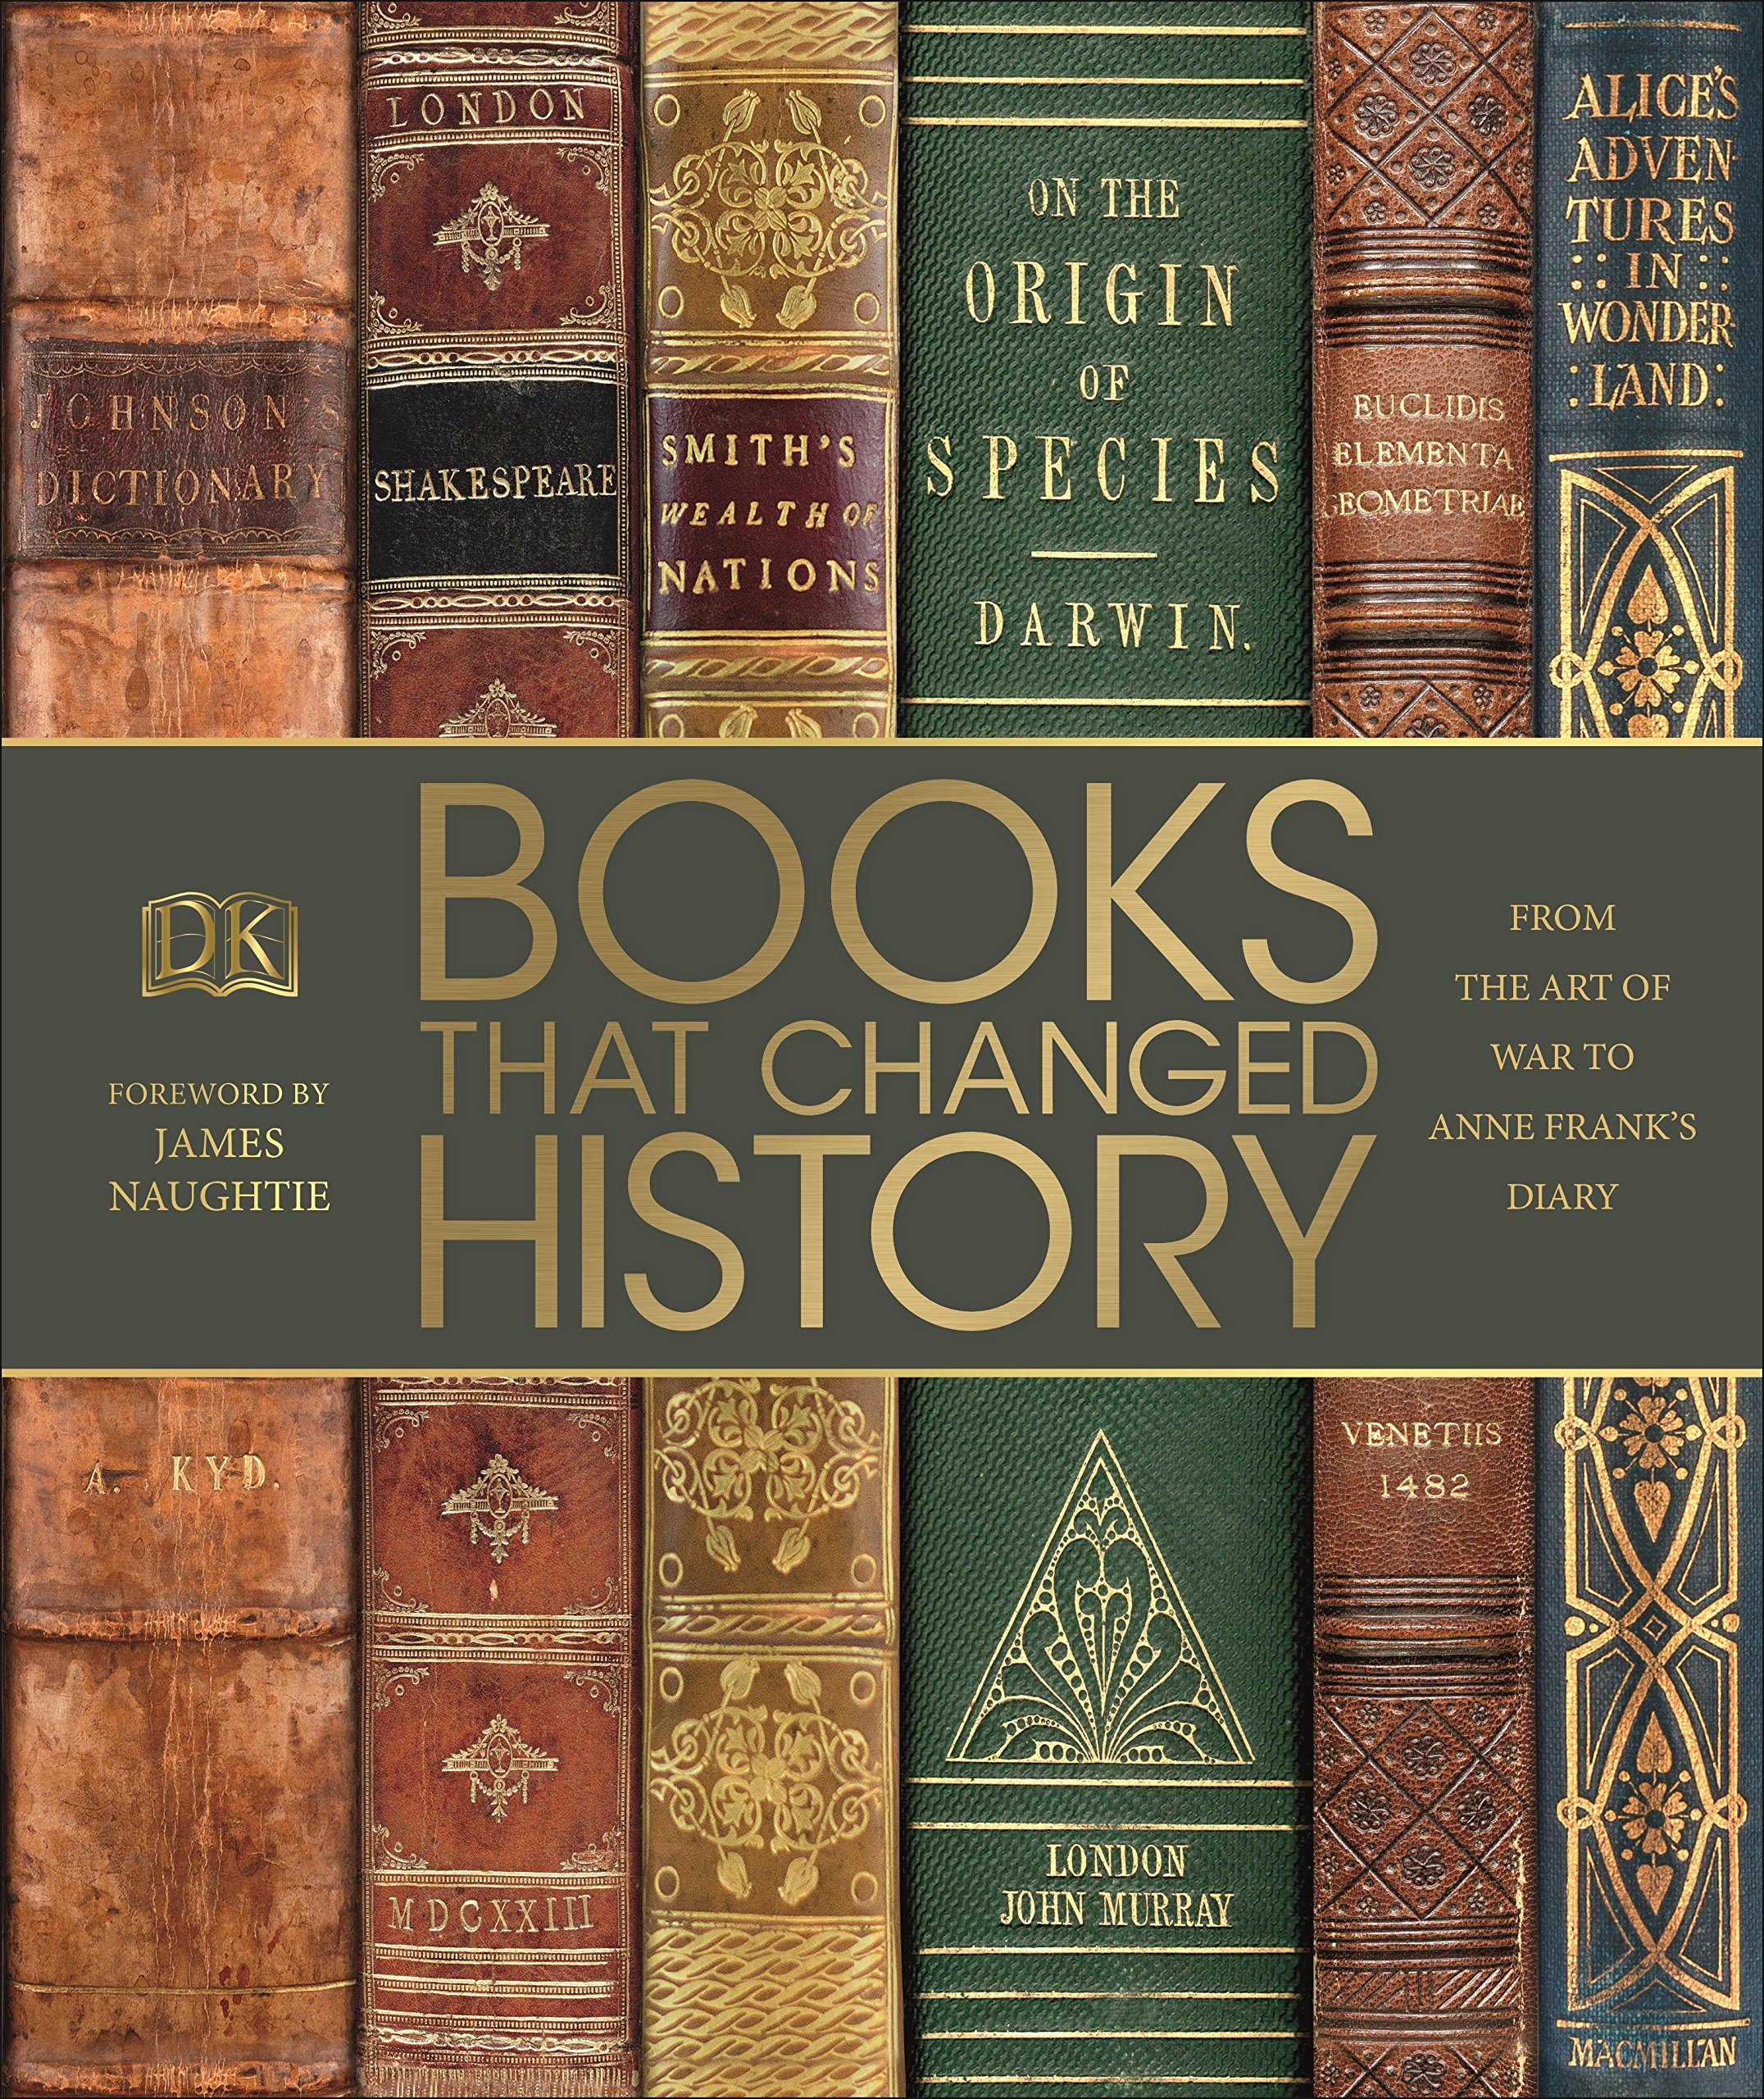
How has reading changed?
HELP
Reading has changed history. Without books, we wouldn’t have history as we know it.
Can you answer the question: ‘Why is reading so important to human civilisation?’
- You can either explain verbally, or write an extended written response.

Slide 5
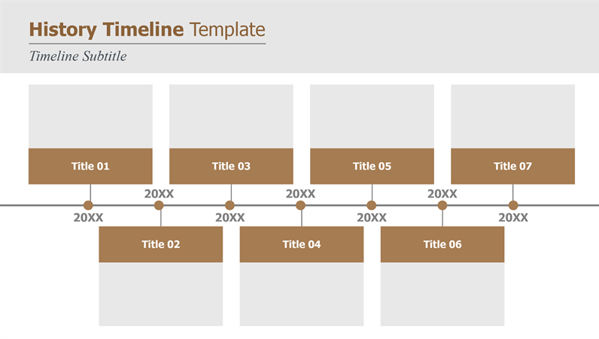
Timeline Task
INDEPENDENT
Bringing together everything you have learnt this week, with a bit of historian investigation, can you devise a timeline that tells the story of reading across human history?
Remember:
Sumer and cuneiform
Monks and handcrafted books
Gutenberg and the influence of printing
Children’s literature

Slide 6
Remember – keep reading, writing and inquiring!

