Slide 1
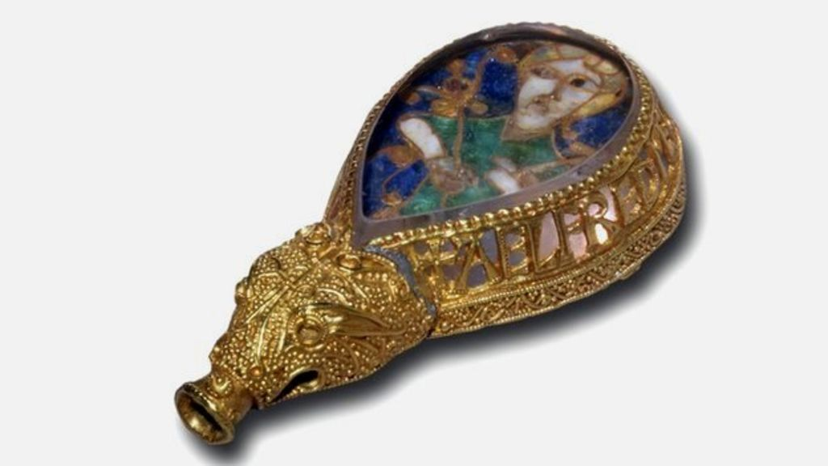
History Week
(Day 2)

Slide 2
What you will need…
HELP
Plain paper, pencil / pen
Laptop
Coffee/teabag for paper staining (optional)

Slide 3
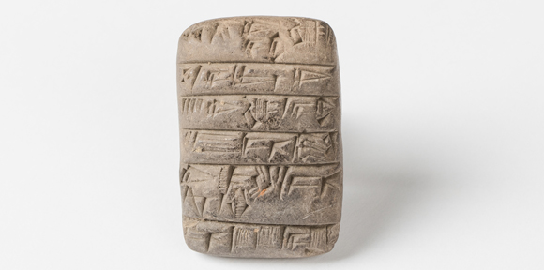
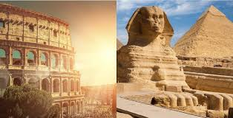
What can you remember?
HELP
What can you remember about the birth of reading and writing in Sumer?
What is a civilisation? (what elements does it include?)

Slide 4
Exploring Objects in History
HELP
What is this object?
How old is this object?
How valuable do you think this object might be?

Slide 5
Exploring Objects in History
INDEPENDENT
This object is ‘King Alfred’s jewel’. A stick was inserted into the hole on the end and it was then used as a pointer – the king would point at the words as he read and follow along.
Find out more here: https://bit.ly/3amDgU0

Slide 6
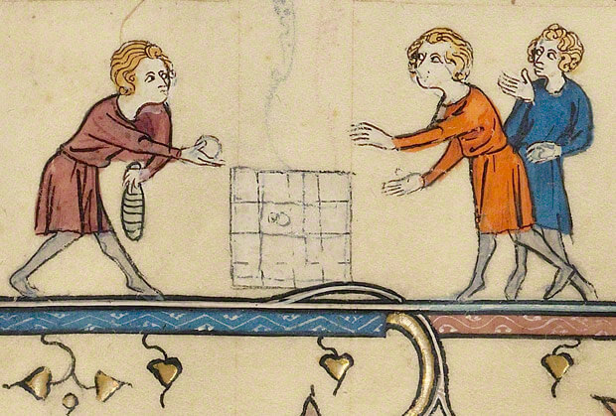
Reading & Writing in Medieval Times
INDEPENDENT
What do we already know about Medieval times (around 5th century CE to the 13th century CE)? Fine out more now: https://bit.ly/2vYIDK8.
Read this webpage and summarise five key facts about Medieval reading and writing: https://www.historyforkids.net/medieval-literature.html.

Slide 7
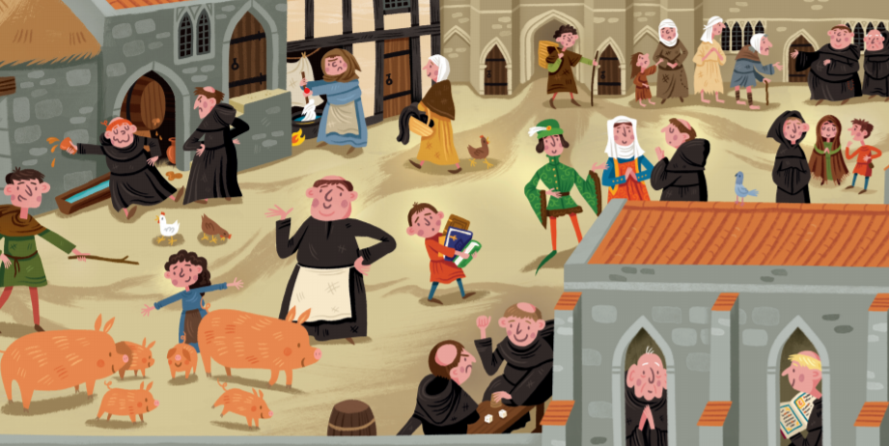
Medieval Monks
HELP
Medieval monks were the authors of their age.
Take a look at their monastery and talk about what it shows about their lives… https://bit.ly/2WNEbZB.
Now, meet the monk: https://bit.ly/3bAv7eR.
Thank you to English Heritage!

Slide 8
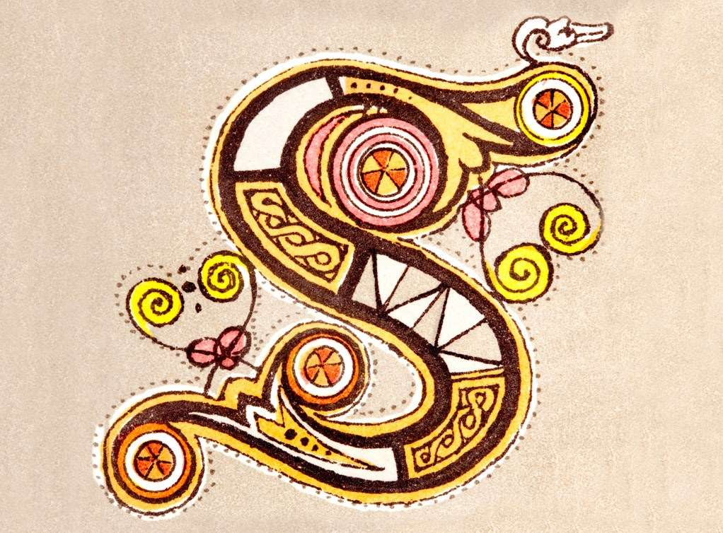
ILLUMINATED INITIALS
INDEPENDENT
In the Medieval age, before printing presses, books were carefully handwritten by monks, so they were expensive and rare. They were often beautifully designed… (watch here: https://bit.ly/3bxM3mc).
Can you design your own illuminated initial? Read about your task here: https://bit.ly/2y634oX.
(You may want to stain your paper with tea/coffee)
Thank you to English Heritage!

Slide 9
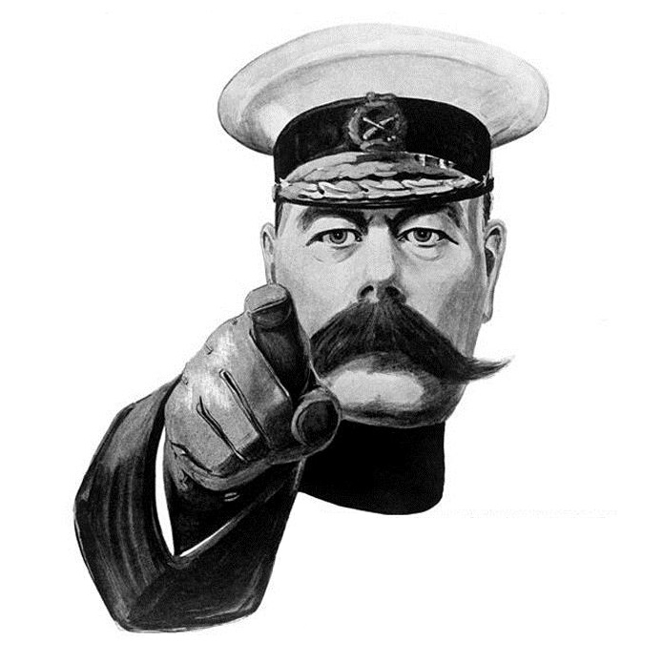
Now, go and write the best story ever written!

