Slide 1
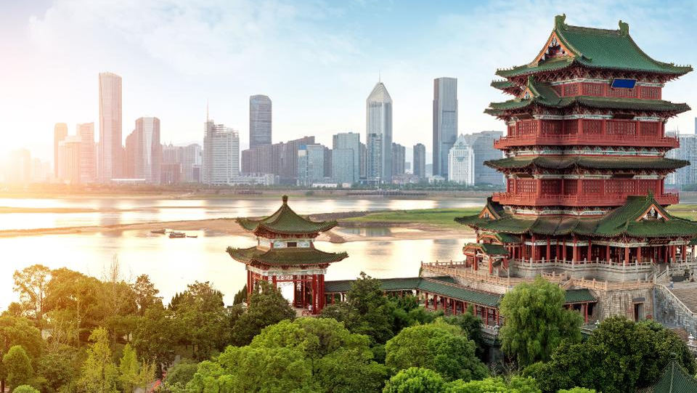
All about China

Slide 2
You will need….
Plain paper (A4…and big paper for later)
Pen, pencil and coloured pens
Computer

Slide 3
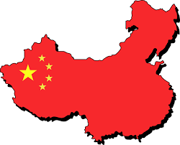
China Fact file
Grab some paper and a pen…
What 5 things do you already know about China?
What do you want to know about China? How might we find out?
What are the 5 most interesting facts you can find about China? [e.g. http://www.sciencekids.co.nz/sciencefacts/countries/china.html]

Slide 4
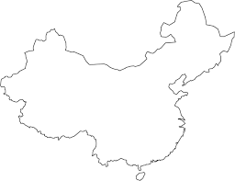
China Map
Sketch the outline of China…then find the major cities to add to your map
(look here: https://www.chinadiscovery.com/china-maps/china-provincial-map.html)

Slide 5
Wild China
Find out more about animals in China here: https://www.youtube.com/watch?v=12tZ-ggQtY0.
Can you observe the behavior of a Panda? Watch LIVE here (https://www.youtube.com/watch?v=Gm3bQVANtVo)
Now, write 6 statements about Panda behaviours based on your observations (REMEMBER punctuation and spelling).

Slide 6
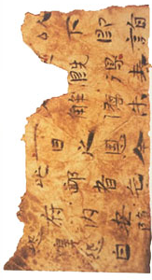
Paper China
Why is China so special to the history of paper?
First, read about ancient China: https://www.dkfindout.com/us/history/ancient-china/
Second, read about the invention of paper: https://www.dkfindout.com/us/history/ancient-china/chinese-paper-making/
Now, write a paragraph about why China is so important to the history of paper.

Slide 7
Paper China
Can you write Chinese?
Watch this video and pick 6 Chinese symbols to write: https://www.youtube.com/watch?v=_GPO0_Ly5LU
Now, write PANDA in Chinese.

Slide 8
The Great Wall
First, read about the Great Wall of China here: https://www.ducksters.com/history/china/great_wall_of_china.php.
Tell Mum and Dad about how the Great Wall was built and pick out the most interesting fact you can find!

Slide 9
Chinese Art
Read about Chinese art history here: https://www.coolkidfacts.com/ancient-chinese-art/.

Slide 10
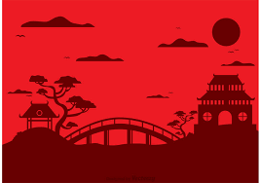
Chinese Art
Can you sketch the outline of this image free-hand?

Slide 11
Bringing it all together
Can you design an ‘All About China’ infographic that brings together lots of what you have learnt about China?
YOU WILL NEED BIG PAPER, PENCILS, PEN AND COLOURS (PAINTS?)
When you are done, you need to explain your amazing creation!

