Slide 1
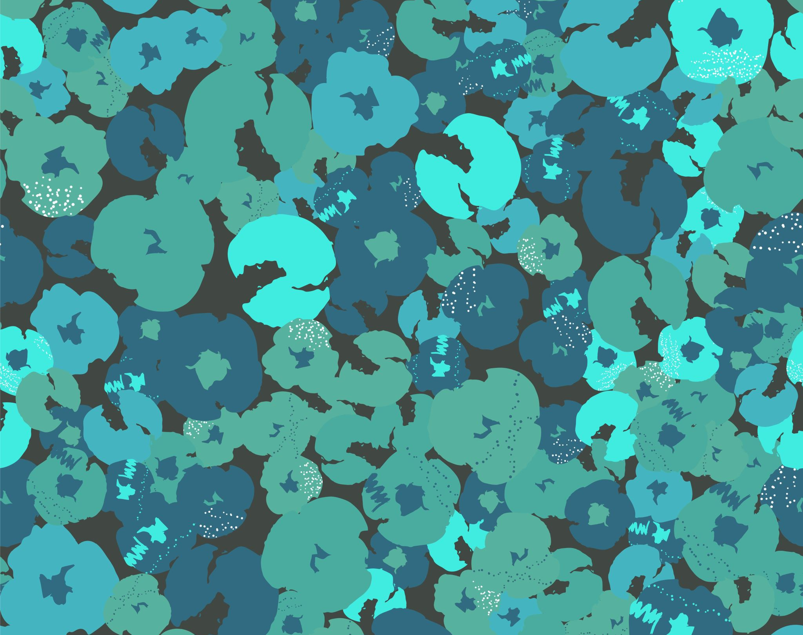
Art Week (day 2)
HELP
Home school

Slide 2
What you’ll need
HELP
Plain paper and pencil/pen
Coloured pens/pencils
Laptop
Scissors (for plant dissection – supervised)

Slide 3
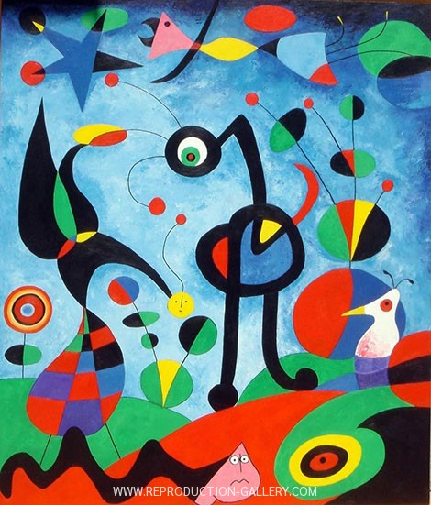
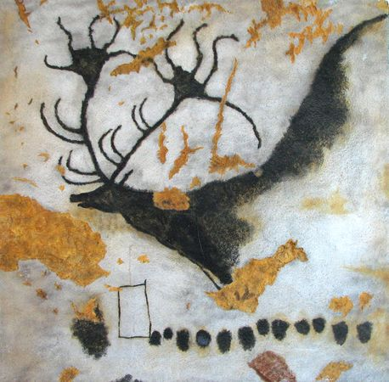
What can you remember?
HELP
What can you remember about cave painting?
What can you remember about the Lascaux Caves?
What can you remember about colour in fine art?

Slide 4
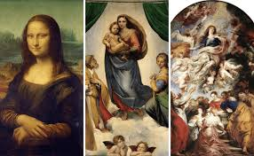
Art hunting – The renaissance
INDEPENDENT
Can you find a painting of ‘Medusa’ by Carravaggio?
https://artsandculture.google.com/partner/uffizi-gallery?hl=en.
Who was Medusa anyway?
What does the word renaissance mean?

Slide 5
Art hunting – The renaissance
INDEPENDENT
What can you find out about Renaissance art?
https://www.khanacademy.org/humanities/approaches-to-art-history/for-the-very-beginner/v/renaissance-art-introduction.
List 5 facts about Renaissance art.

Slide 6
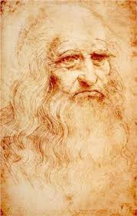
Art hunting – Leonardo da vinci
INDEPENDENT
What do we know about Leonardo da Vinci?
https://www.teachingideas.co.uk/sites/default/files/leonardodavincifactcards.pdf
What are his 3 most famous pieces of art? Create a slide including all 3. Can you explain them and their importance?

Slide 7
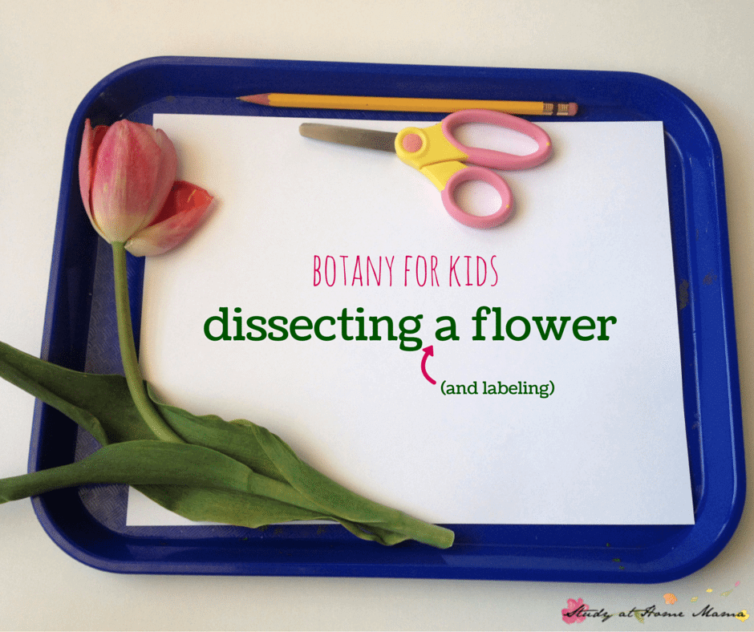
Leonardo’s Science
HELP
Leonardo was interested in dissection – cutting and analyzing bodies and plants.
Can you dissect and label a spring plant or flower?

Slide 8
Art hunting – Leonardo da vinci
INDEPENDENT
Create a full fact file of Leonardo da Vinci:
His life
His art
His inventions
His scientific ideas and interests
The world and countries he lived in.

Slide 9
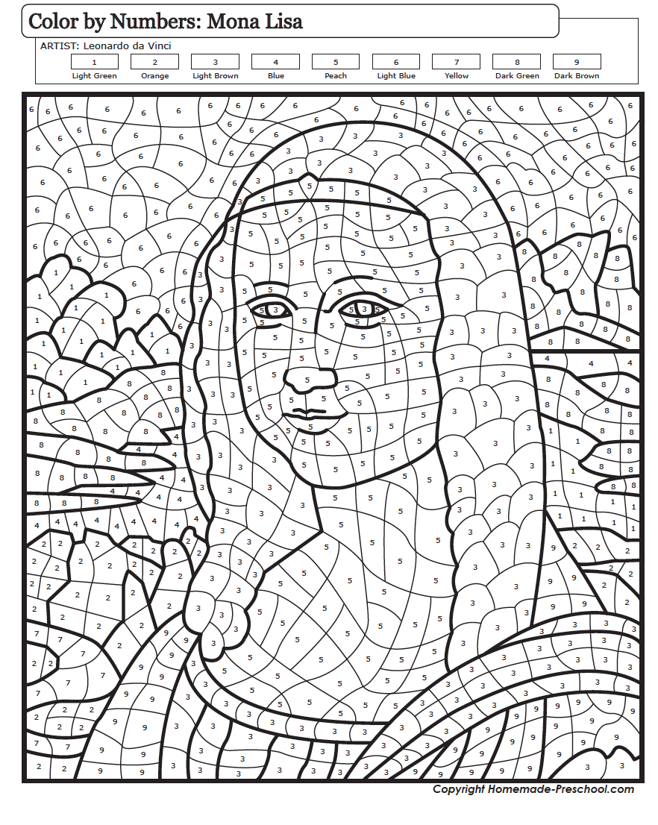
Colouring in!

