Slide 1
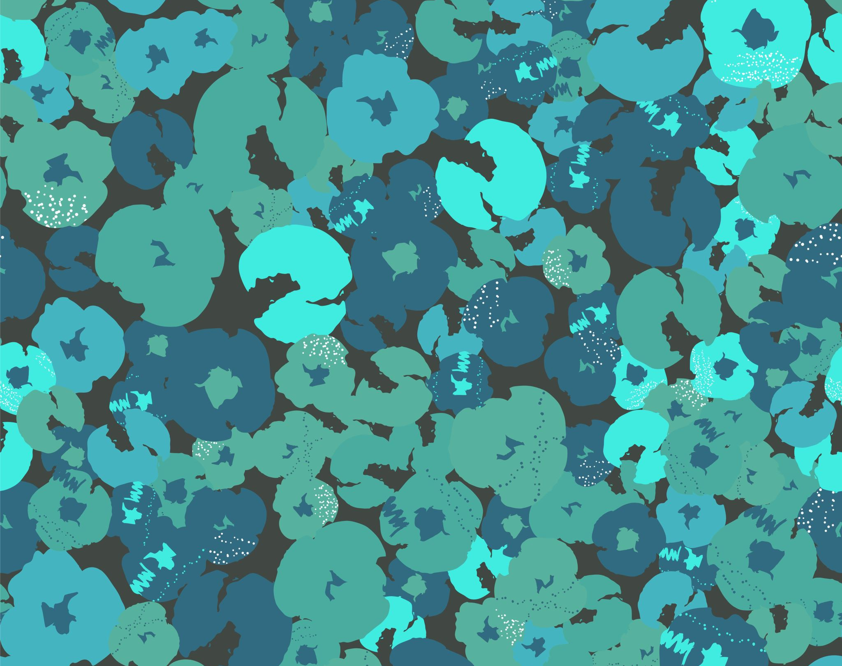
Art Week (day 1)
HELP
Home school

Slide 2
What you’ll need
HELP
Plain paper and pencil/pen
Paint and paint brushes
Laptop
Coffee/tea for staining!

Slide 3
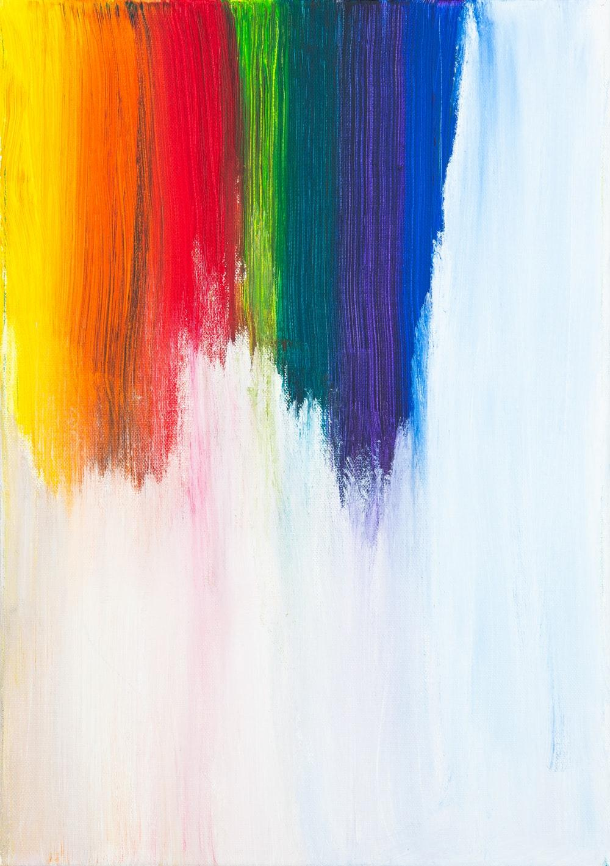
What is art?
HELP
Can you tell me what art is?
Why do we create art?
How do you feel when you draw/paint/sculpt?

Slide 4
'Fine art’ - Cave painting
INDEPENDENT
The first known art was cave painting…Read and find out more: https://kids.kiddle.co/Cave_painting.
Answer the following questions:
What were the different styles of painting?
Why did people paint in caves?

Slide 5
Colour and painting
INDEPENDENT
Colour has always been central to fine art. Research the following colours: blue, red, yellow and green: https://www.canva.com/learn/color-meanings/.
Pick a colour and write a paragraph explaining how you make the colour; what it might mean; what examples we have of it in art or in our world e.g. famous products.

Slide 6
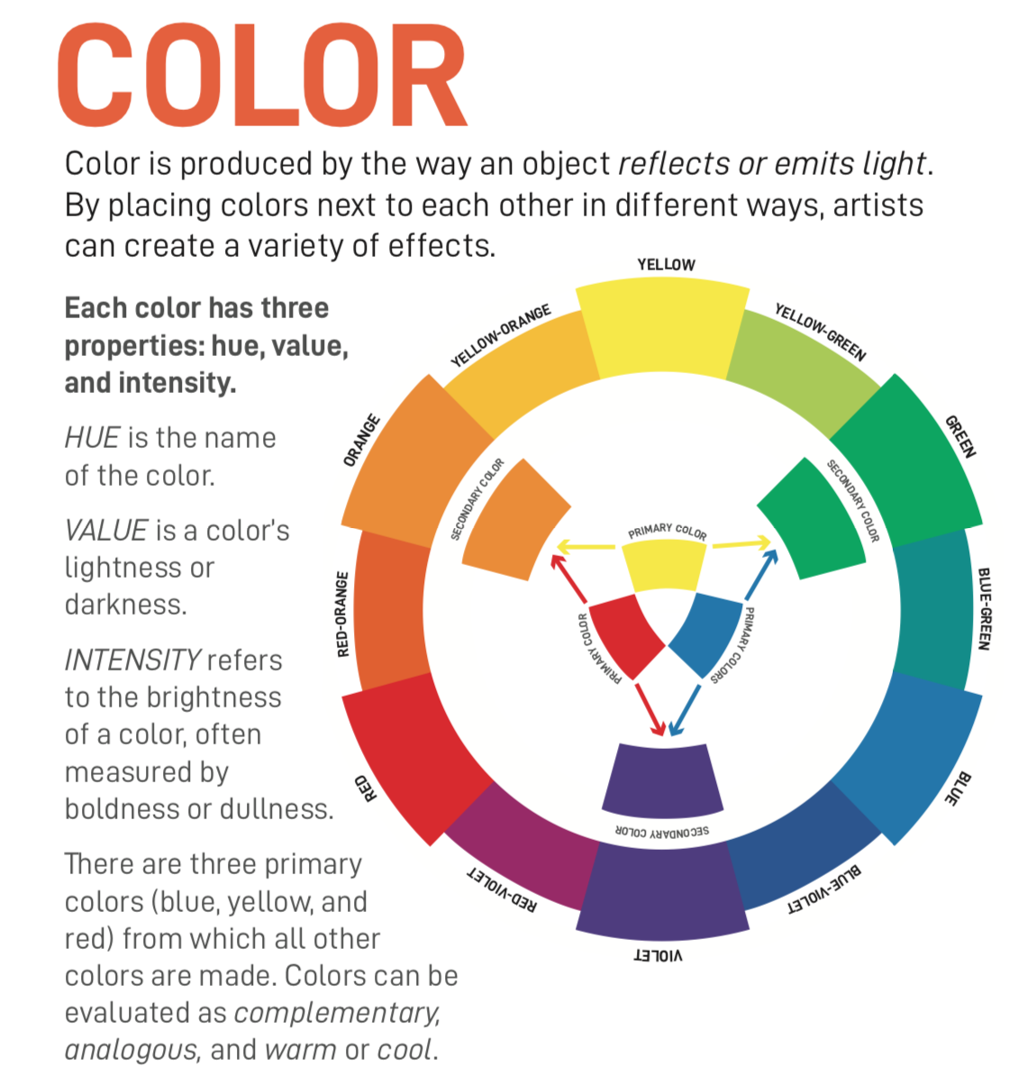
The colour wheel
INDEPENDENT
Find out about the colour wheel: https://www.youtube.com/watch?v=RuV81WORajk.
Read about hue, value and intensity

Slide 7
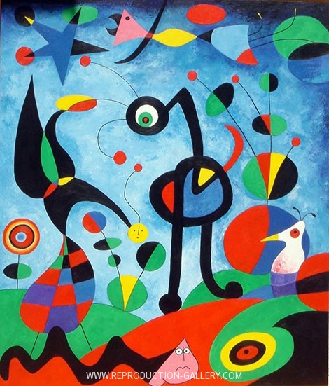
THINK AND TALK ABOUT COLOUR
Describe the COLOURS in this artwork.
How do the COLOURS in this artwork make you feel?
What COLOUR schemes did the artist use: complementary, warm, cool, etc.?
MIRO, THE GARDEN (1925)

Slide 8
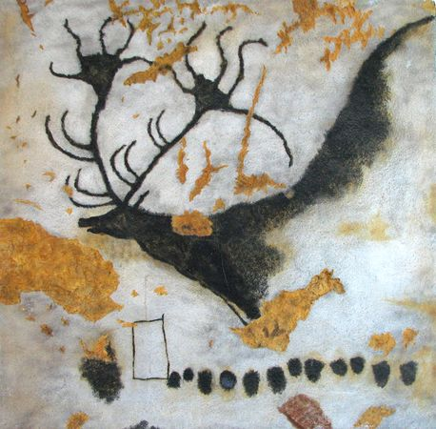
Lascaux Caves
INDEPENDENT
Find out about the first known cave paintings:
https://kids.kiddle.co/Lascaux.
Where are the caves?
When do we think the paintings were made?
What problems did they have with the original cave?

Slide 9
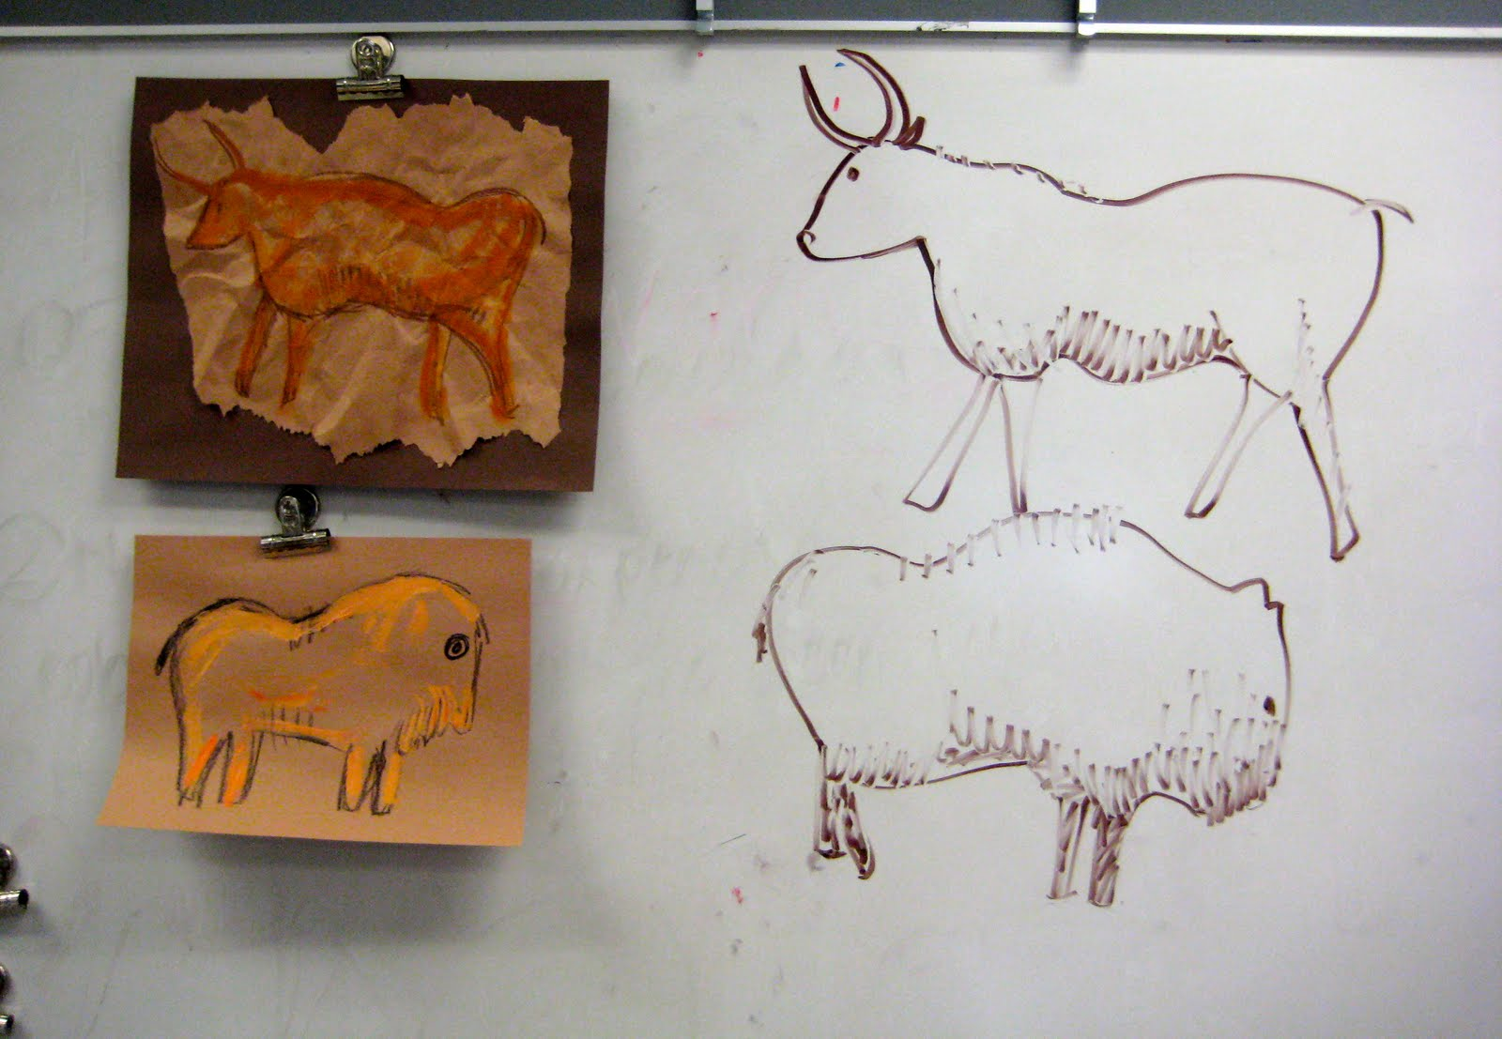
Cave painting
HELP
Can you create your own cave painting?
How might you ‘age’ the paper (e.g. teabag,
Coffee grounds; crinkling paper)?
Can you paint/draw a hunting scene?
What colours will you use and why?

